Slide 1
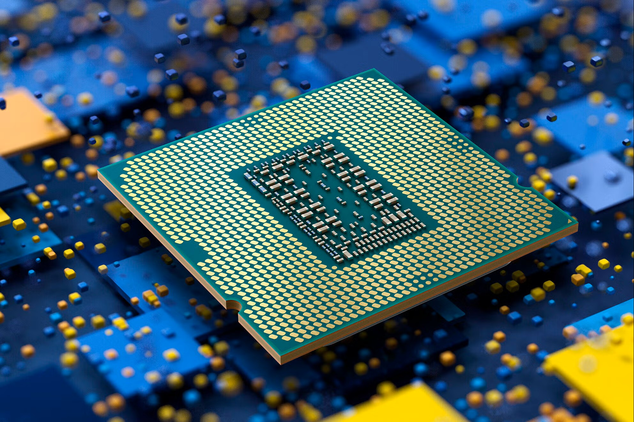
Multithreaded Scene Change Detector in Java
PRESENTED BY:
Mohamad Hassan Ibrahim 6321
Reem Kanaan 6315

Slide 2
Introduction
What is scene change detection?
Detecting when the video suddenly switches from a specific scene to another
Why is it useful?
Video Summarization
Video Editing
The challenge:
Efficiently detecting scene changes in large video files

Slide 3
Objectives
Implement and compare three approaches to scene detection:
Single-threaded
Multi-threaded (no queue)
Producer-consumer (queue-based)
Highlight performance improvements with multithreading

Slide 4
Approach 1 – Single-Threaded Scene Detection
Read all video frames sequentially
Compare each frame to its neighbor to detect scene changes
Simple but slow for large videos

Slide 5
Approach 2 – Multithreaded without Queue
Extract all frames using 1 thread
- Divide frames into equal chunks
- Each thread takes a chunk of frames to do the detection in parallel
Pros: Faster than single thread
Cons: All frames must be loaded first

Slide 6
Approach 3 – Producer-Consumer Model
Single Producer Thread:
Extracts frames in real time, pushes each frame into a shared queue
Multiple Consumer Threads:
Each takes frames from the queue and checks for scene changes
Advantages:
Efficient resource usage
Work as frames are extracted (closer to real-time processing)

Slide 7
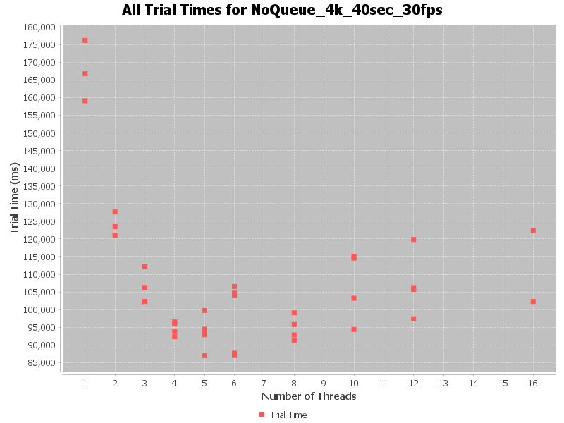
Approach 2 tests on 40sec-30fps video

Slide 8
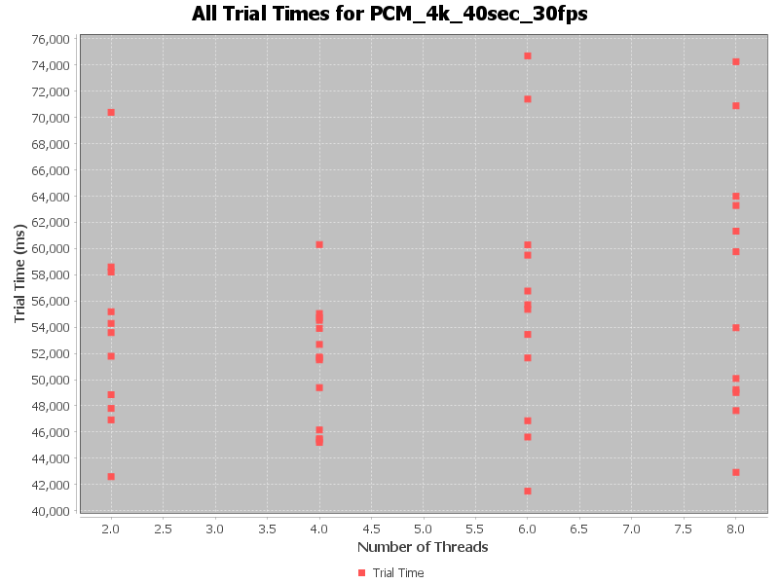
Approach 3 tests on 40sec-30fps video

Slide 9
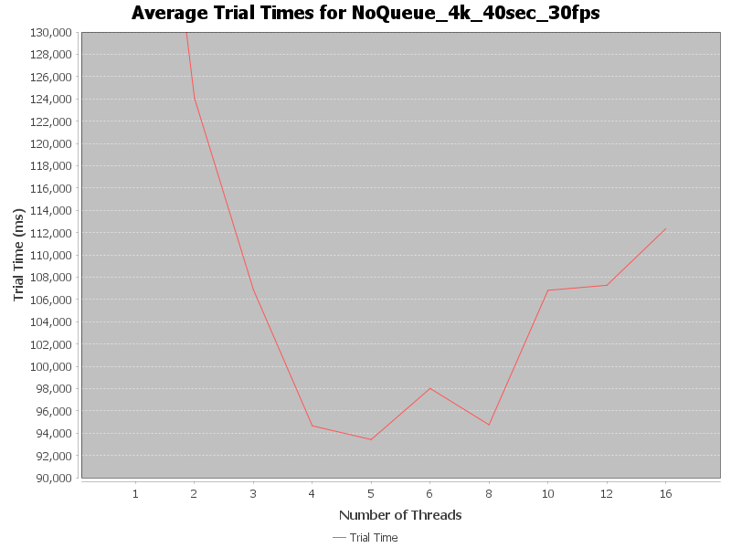
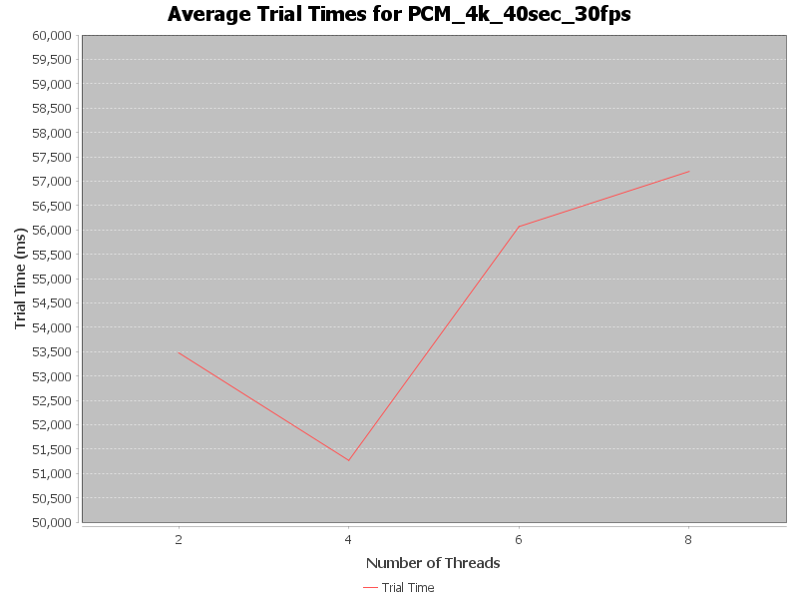
Approach 2 vs Approach 3 on a 40sec-30fps video

Slide 10
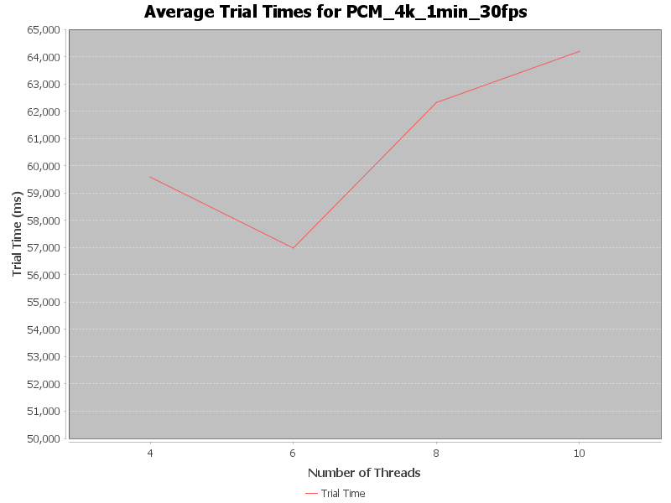
Approach 3 test on 40sec-30fps video and 1min-30fps video

Slide 11

End of Presentation

